Slide 1
Wearable Smart Patch Concepts
10-Feb-2025

Slide 2
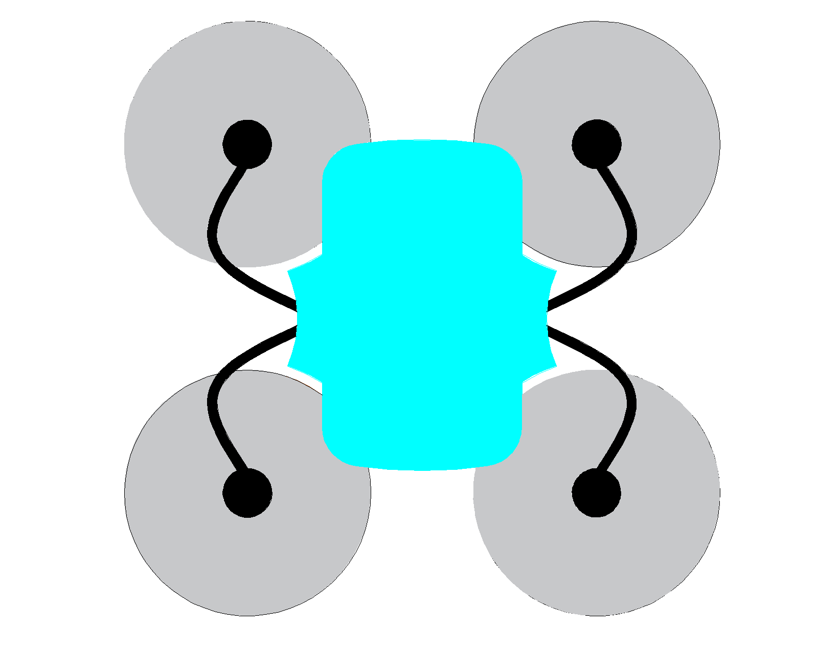
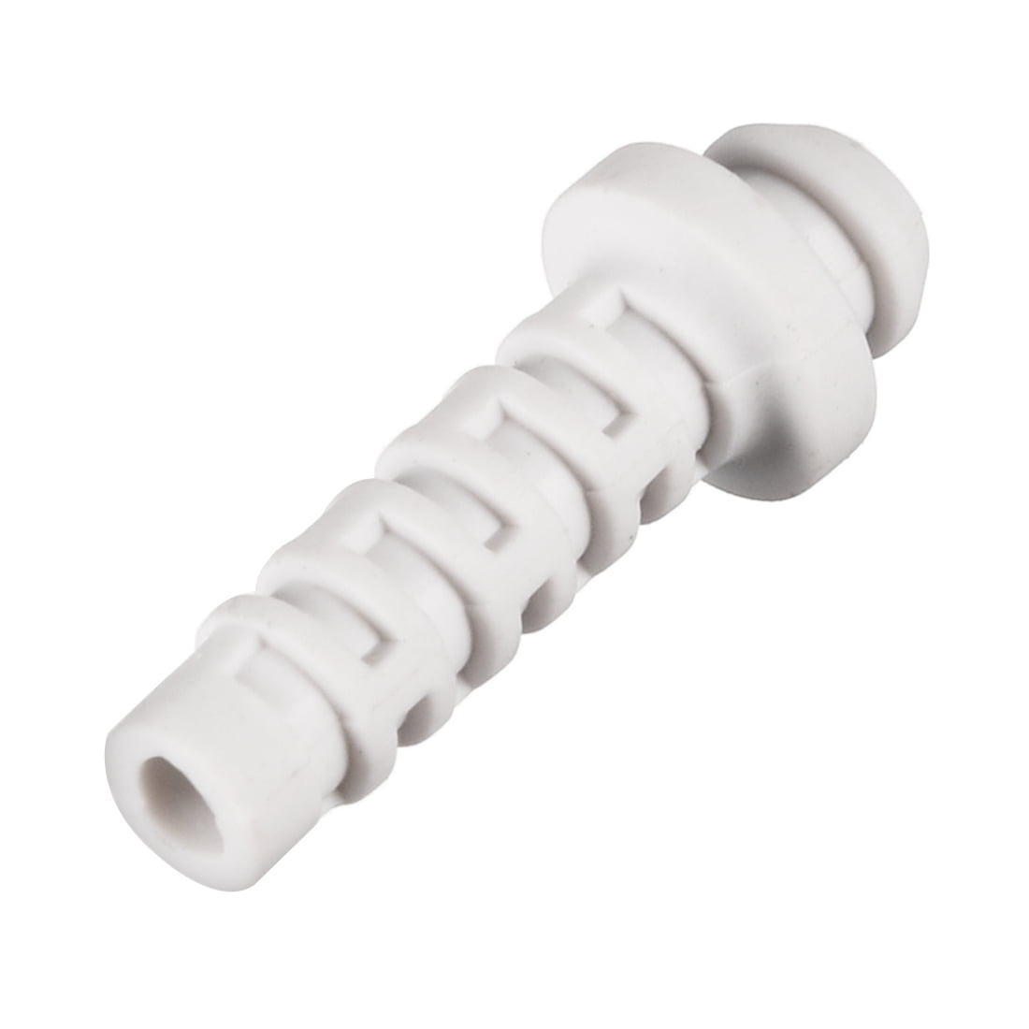
Concept 01
Electrodes and Temperature Sensor
ECG Cables
Cable Gland
Note: If required we can use a Cable gland to protect the Wires and will rest on the electrode
Notes:
The blue body (enclosure will not have glue/adhesive and will be supported in the air via Cable glands
The cable Glands will be flexible guides allowing ECG cables to pass through.
The Electrodes will be the elements with adhesive to hold on to the Body [high strength adhesive(acrylic) will be required] .
Can achieve IPX4 rating
Can change electrode position within 2" range

Slide 3

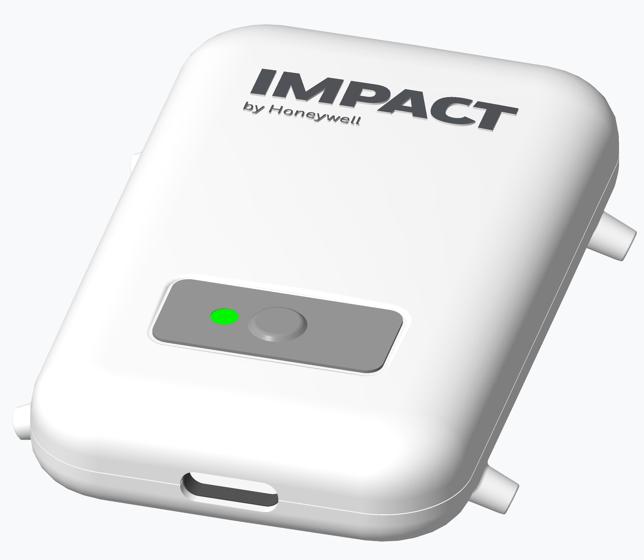
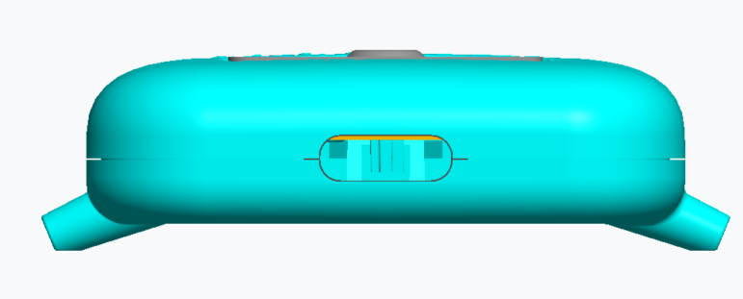
Concept 02
Notes:
The blue body (enclosure will not have glue/adhesive and will be supported in the air via rigid plastic guides
Fixed electrode position
The Electrodes will be the elements with adhesive to hold on to the Body [high strength adhesive(acrylic) will be required] .
Can achieve IPX4 rating
Rigid Enclosure can cause discomfort to the patient

Slide 4
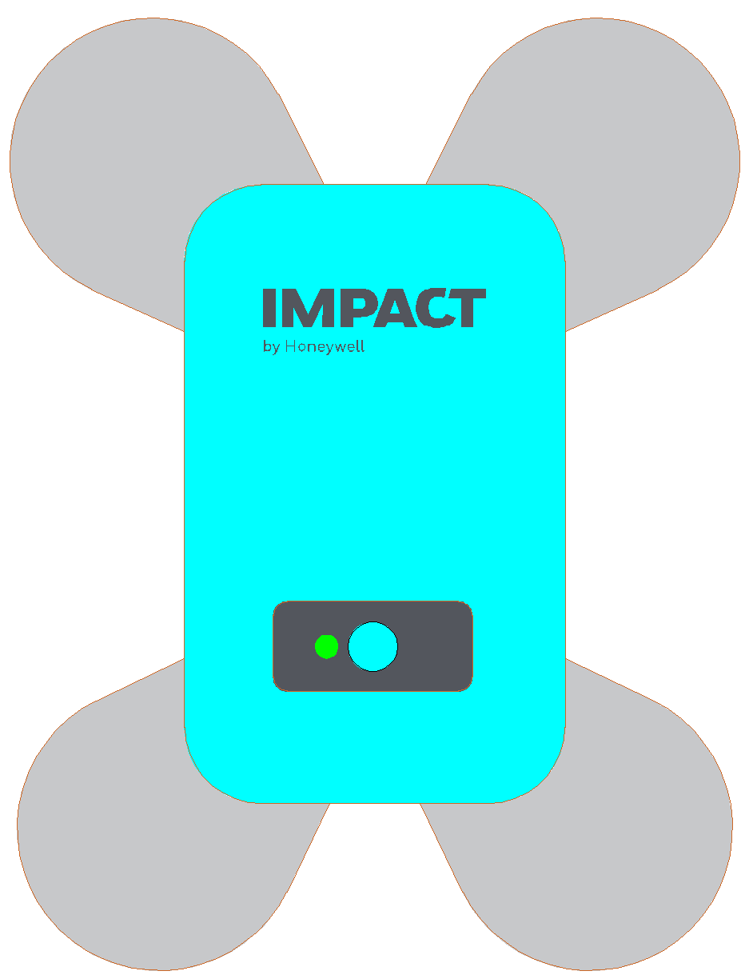
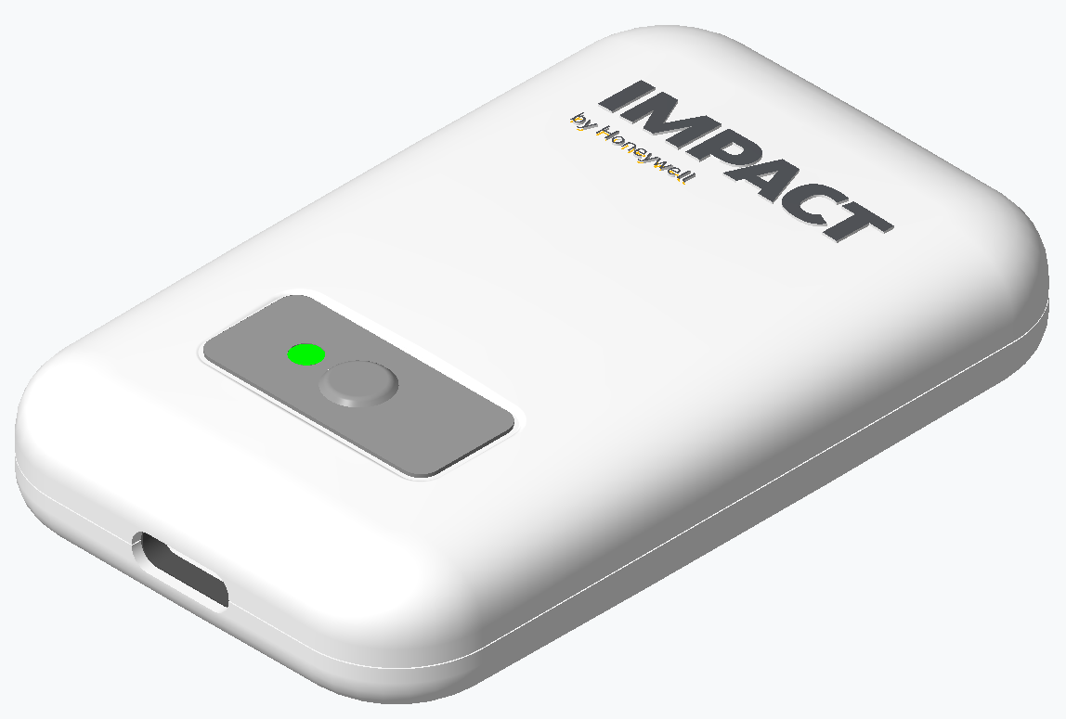
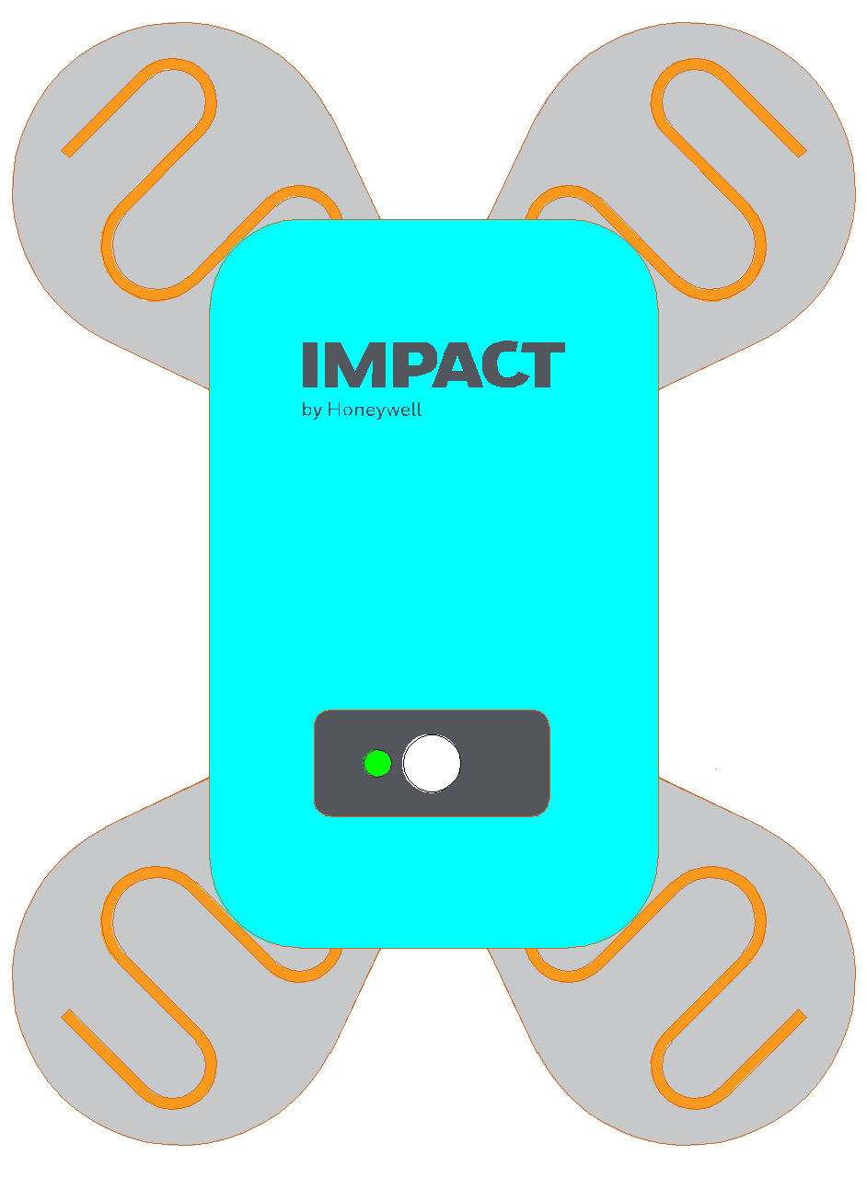
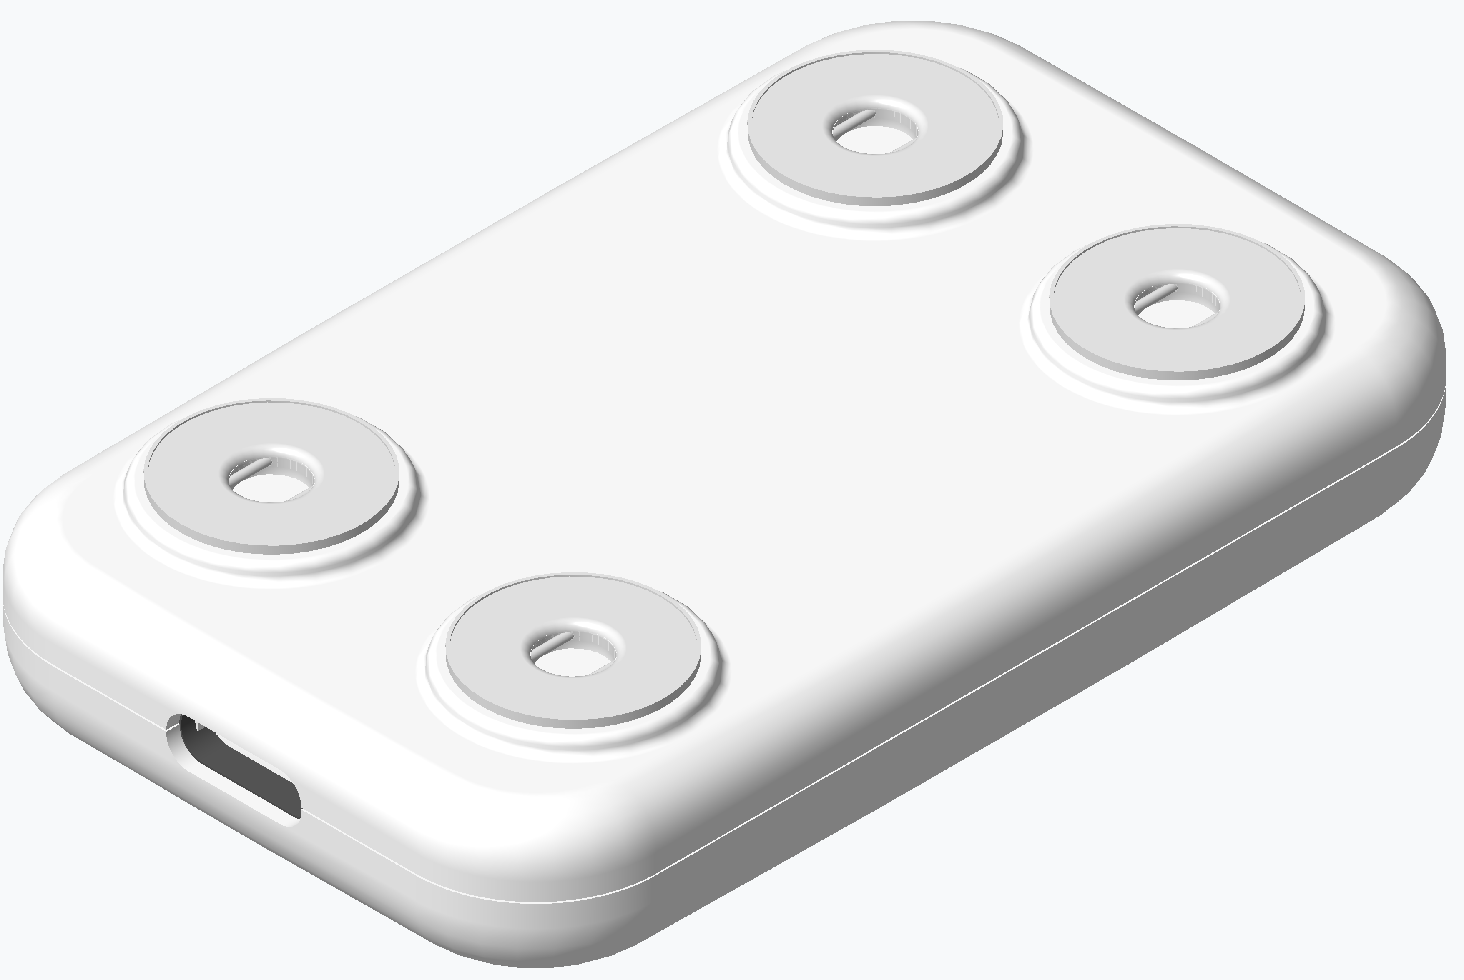
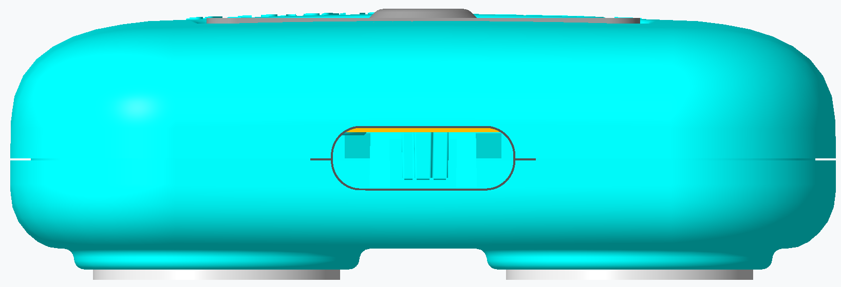

Concept 03
Offset Electrodes and Temperature Sensor
Electrode with Printed Electronics
Notes:
The blue body (enclosure will not have glue/adhesive and will be supported in the air via Snap Buttons
The snap Buttons will connect to a customized Patch with Signal Track
The Electrodes will be the elements with adhesive to hold on to the Body [high strength adhesive(acrylic) will be required] .
Can achieve IPX4 rating
Can design Different sizes/lengths of patches as per requirement.

Slide 5
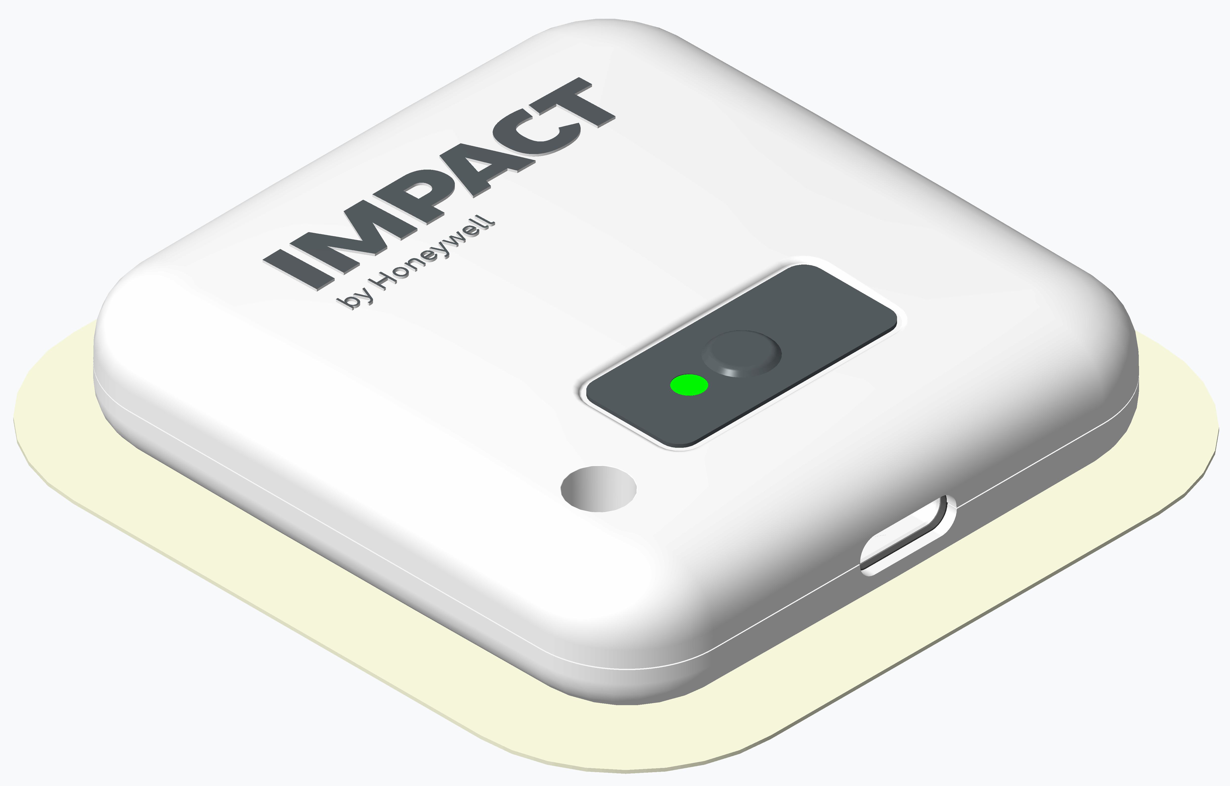
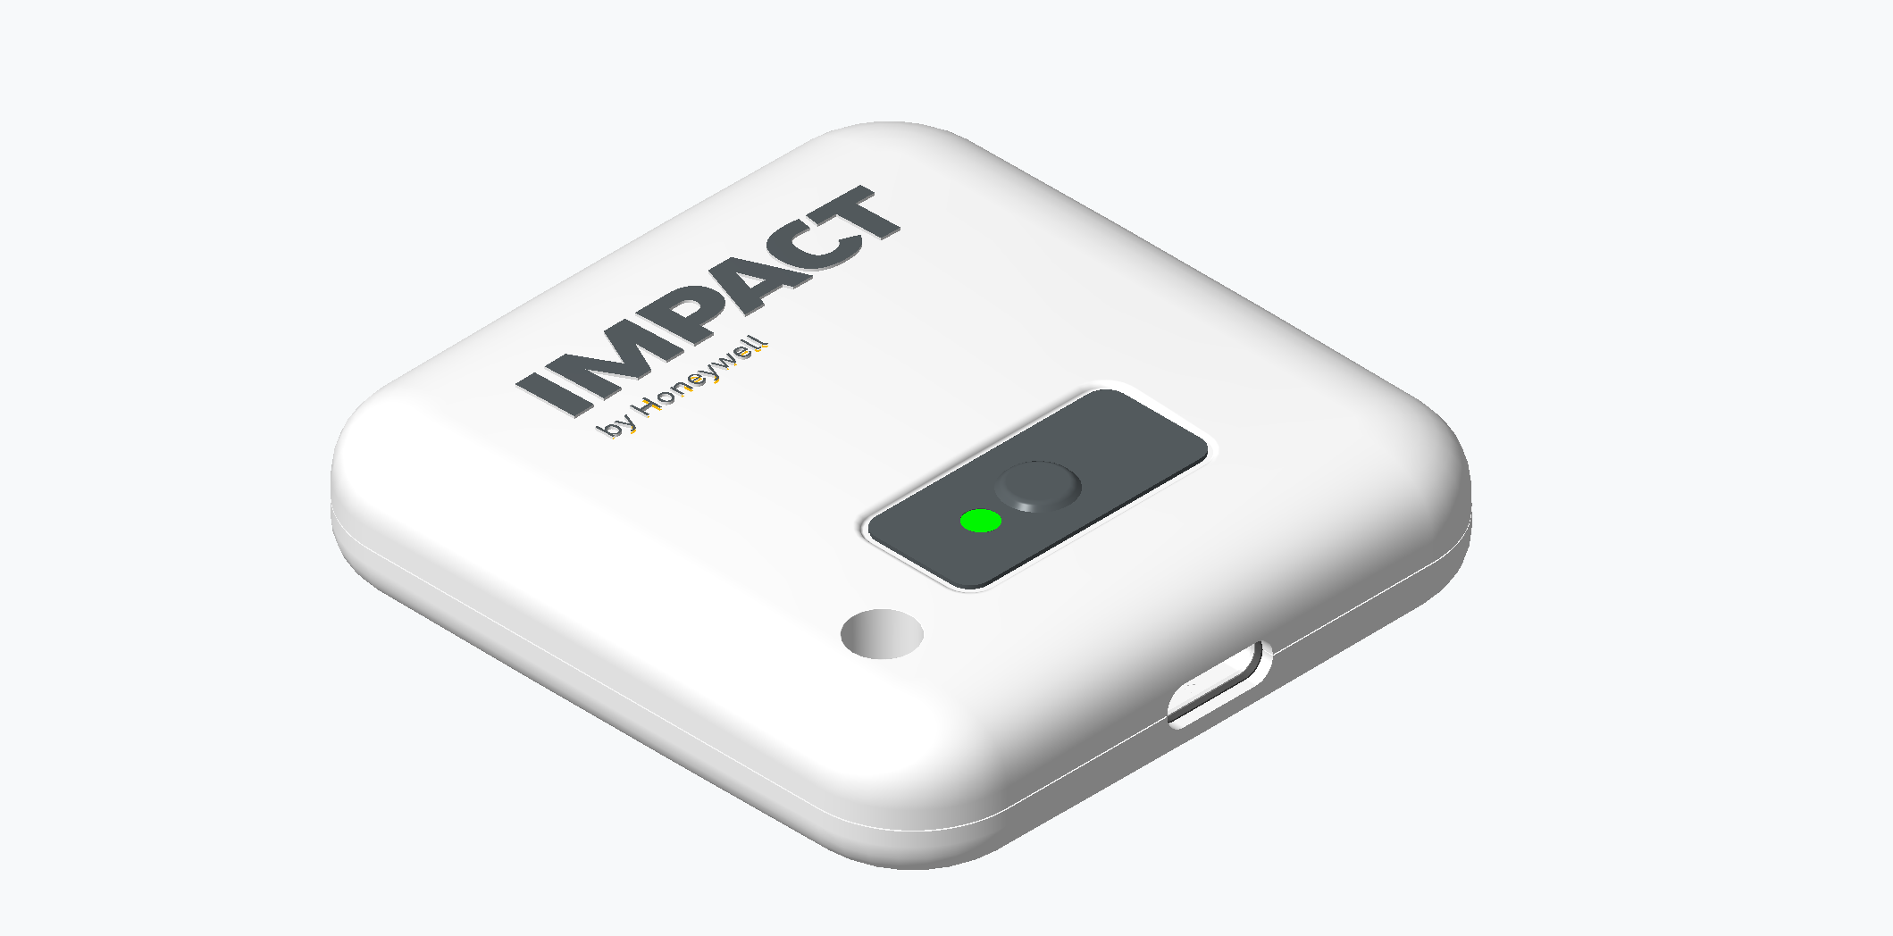
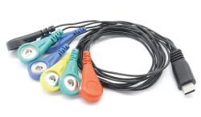
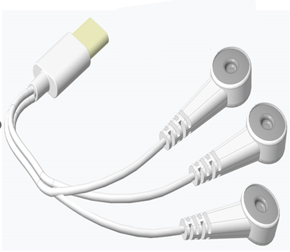
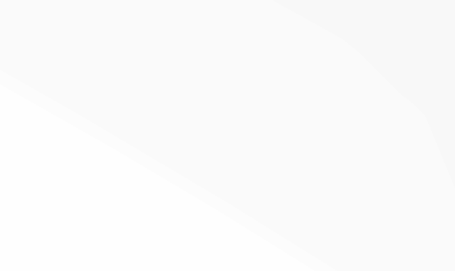
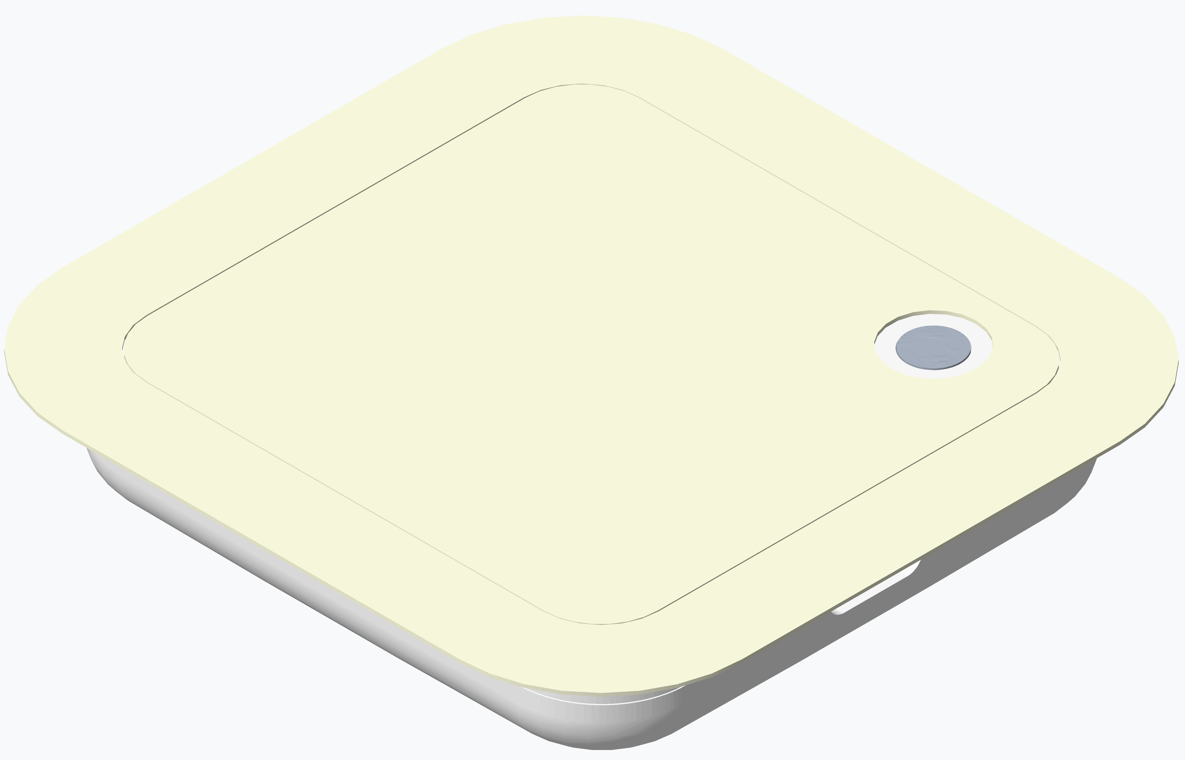
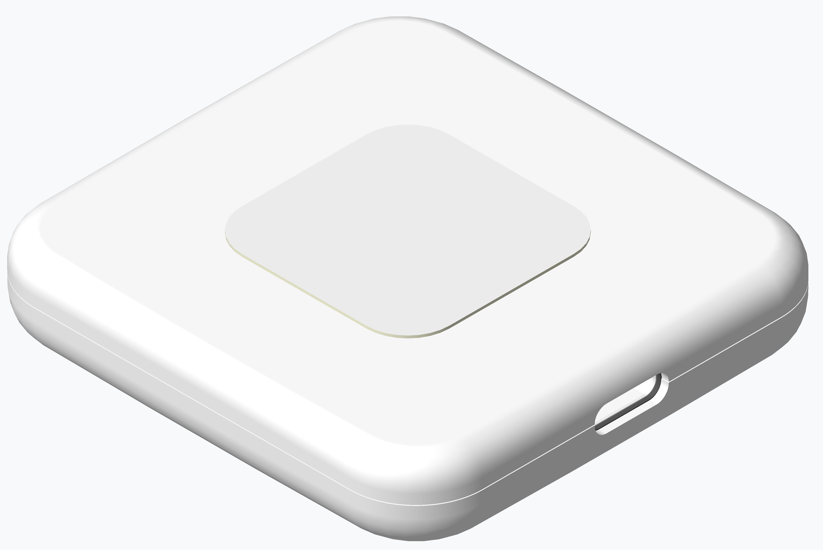
Concept 04
Existing POC
Proposed Concept
20” ECG cable
6” ECG cable
Patch
Notes:
This is the same device that was use at NH for Demo in December.
The cable length is shortened
The adhesive patch area is reduced and kept at the center of the device.

Slide 6
Decision Matrix

